Slide 1
Ordinary Differential Equations
PHYS3112 – Tutorial 4

Slide 2
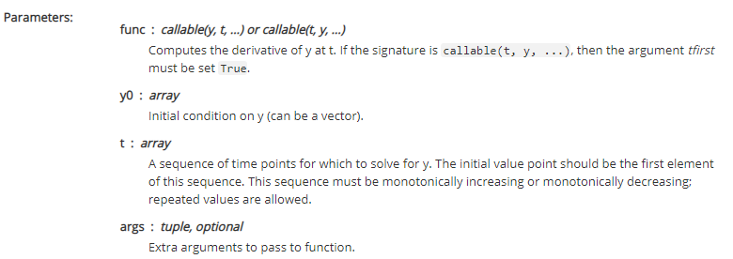
What is ODE Int?
Ordinary Differential Equation Integrator that will integrate a certain function ‘func’
The principal challenge in using ODE in is writing your function

Slide 3

Writing your ODEint-able function
Your function / derivative COULD depend on time (t), or it could depend on the current status of the system (y).
It’s inputs must be y, t and then others.
‘y’ can be a vector, meaning it can actually be a variable containing many values
It must return the set of dy/dt (i.e. one derivative for each ‘y’ we have input)’
y
FUNC
dy/dt
t

Slide 4

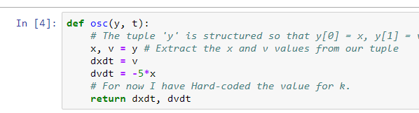
What about – two variables?
Use a tuple / vector!
Outside the function, write two variables to ‘y’ (eg y = x, v)
Inside the function, extract the two variables from y (eg x, v = y)
Make sure your function returns two derivatives if you’re using two variables (and that they’re in the correct order!)

Slide 5
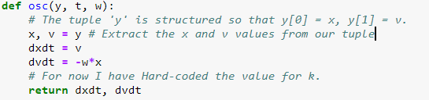
What about – extra parameters?
Pass them after the other variables: odeint(func, y, t, here!!)
Outside the function, group them together as a tuple (comma separated values) – even if there’s only one of them.
Pass them to ODE int
In the function, have a space for the tuple in the definition, and then unpack the tuple in the body

Slide 6
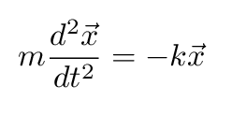

Normal Form Functions
ODE int can only handle first derivatives. If you have something with a second derivative, you need to make it into first-derivative only form. We normally do this by introducing intermediate variables.
For example, the simple harmonic oscillator;
We would define v = dx/dt and express this equation as two equations using both x and v:

Slide 7

The Assignment!
1 . Turn the Coupled Pendula equations into a series of 1st order ODEs
2. Simulate them for various conditions (l, k etc).
3. Analyse the results using Fourier methods and compare to your experiment!

Slide 8
GO AND LOOK AT MICHAEL’S NOTEBOOK (THEY ARE VERY GOOD)
Mcba2-numerical integration of ODEs
https://github.com/phys3112/intro/blob/master/mcba2-numerical-integration-of-ODEs.ipynb

